Slide 1
Encryption of JS Requests
Use Case ☺

Slide 2



Bus Service Providers
Travels A
Travels B
Travels C
User

Slide 3

Bus Service Providers to Online Booking Service Provider
Travels A
Travels B
Travels C
Bus Booking Service Provider
User

Slide 4
Ways to Retrieve the Buses Information
User
Bus Booking Service Provider
Travels
Scaping the Website and retrieve the Bus fares and Details.
Use the same requests of travels and retrieve the data and populate into website.
Use the API provided by the travels

Slide 5
Ways to Retrieve the Buses Information
User
Bus Booking Service Provider
Travels
Scaping the Website and retrieve the Bus fares and Details.
Fares and other details will be continuously changing, difficult to keep up with the updated values
Use the same requests of travels and retrieve the data and populate into website.
Unauthorized use for getting the bus details and fares (Handling this situation)
Use the API provided by the travels
Authorized usage of getting the bus details and fares (Need to purchase the API calls or need to have an agreement between the companies)

Slide 6
Handling Unauthorized Access of requests
Bus Booking Service Provider
Travels
Maintaining the configuration of domain specific requests access
Encrypting the requests and Obfuscating the Java script code (Basically protecting JS code).

Slide 7
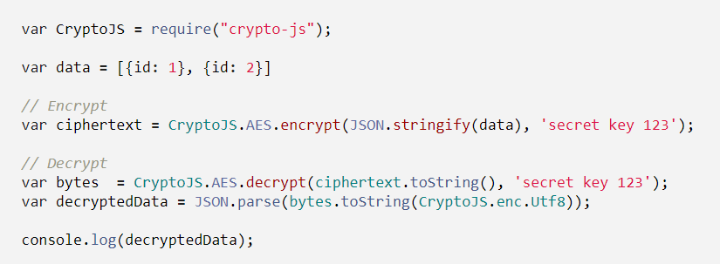
Encryption of data
Encrypt the data before sending the request using standard encryption libraries
Example: Crypto JS is a library used for encryption and decryption of data requests
encryption and decryption of object using AES Encryption Algorithm

Slide 8
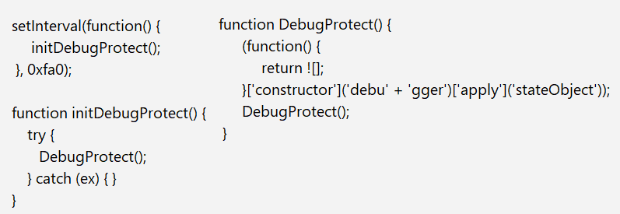
JS code Protection
Code Obfuscation
Different online tools like obfuscator.io are available for code obfuscation. It makes the code into unreadable format
Debugger protection
Making such that debugging of code is not possible
Above methods enables the debug protection

Slide 9
More questions?
Drop a mail to: gsundeep.tech@gmail.com
Notes:
In Slide Show mode, select the arrows to visit links.

